Slide 1
Net Zero storybook intent and content
Jacqui Vitas
21st August 2025

Slide 2
This inspiration for a Net Zero storybook
Observations
Net Zero progress and impacts like so many other topics is cross-cutting across climate, environmental, economic, and social themes.
There are often many agencies/organisations involved or will be potential involved in measuring Net Zero progress and impacts.
There are many existing frameworks and indicators available.
It would be useful to increasing understanding of the core and broader Net Zero story
It would be useful to gather some country case studies of existing approaches.

Slide 3
With these observations the intent of the Net Zero Storybook is to….
Raise awareness:
Of what Net Zero is, why it is important.
Of existing international commitments made by countries signed up to the Paris Agreement (Biennial Transparency Report (BTR)
That the Net Zero measurement story is more wide ranging than greenhouse gas emissions (like wellbeing is more than GDP) – and examples of other areas.
Of the existing statistical frameworks and indicators available
Provide:
- Some country case studies of telling the story of their Net Zero policies, initiatives and their impacts; and where existing statistical frameworks and indicators have been used.

Slide 4
Net Zero measurement framework
Net Zero ++
Wider economic, social, and environmental impacts
Net Zero +
Balance between anthropogenic emissions
and removal/absorption
Core Net Zero
GHG emissions
to reach Paris Agreement
targets
Notes:
Net Zero+ | OECD

Slide 5
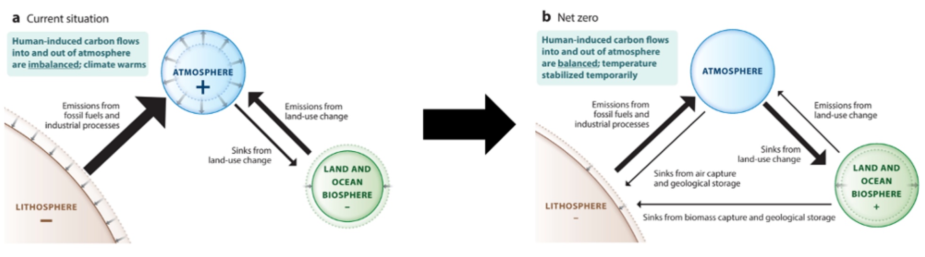
Net Zero +
Notes:
annurev-environ-112320-105050.pdf

Slide 6
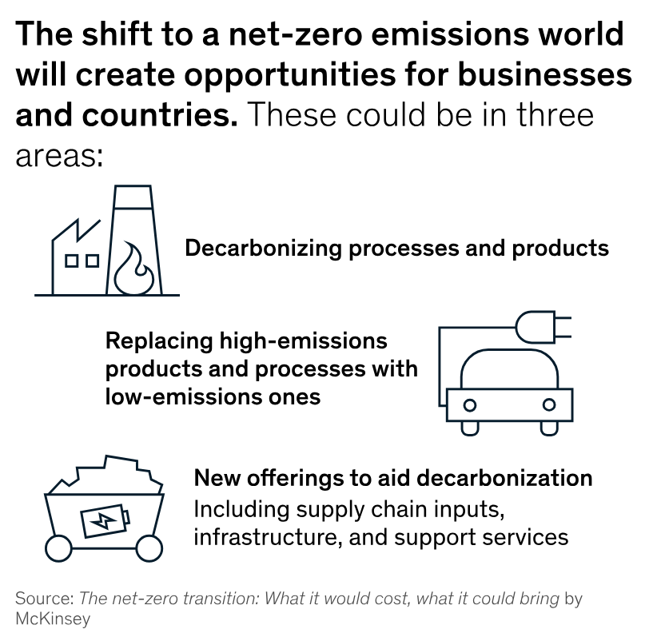
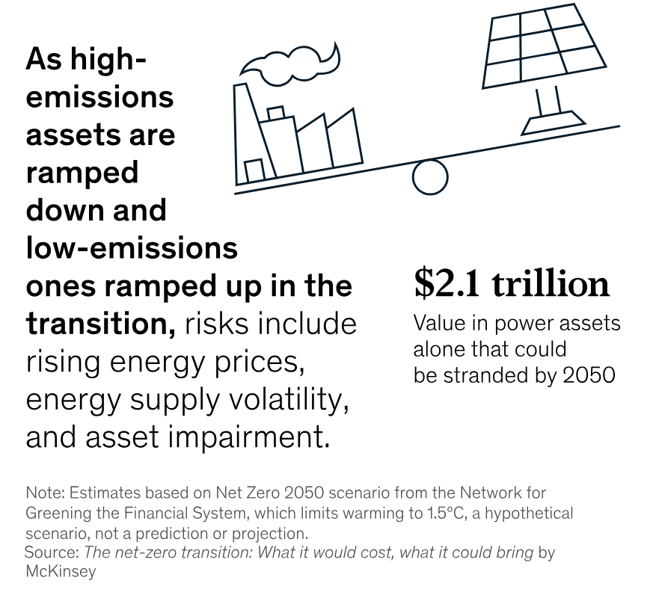
Net Zero ++ examples: businesses, prices, supply
Notes:
McKinsey report Six characteristics that define net zero | McKinsey
The economic transformation needed to achieve the transition to net zero will be significant. Our analysis focuses on demand, capital allocation, costs, and jobs. Looking just at capital allocation, we find that annual spending on physical assets in the energy and land-use systems through 2050 would need to be about 60 percent greater than it is today, rising by $3.5 trillion annually on average.
We assess the net-zero transition along two dimensions: sectors and geographies. For the first, we examine energy and land-use systems that account for about 85 percent of global emissions: power, mobility (in particular, road transportation), industry (steel and cement production), buildings, agriculture and food, and forestry and other land use. We also looked at fossil fuels that supply energy to many of these systems. For the geographic dimension, we analyze effects in depth for 69 countries, which make up about 95 percent of global GDP.

Slide 7
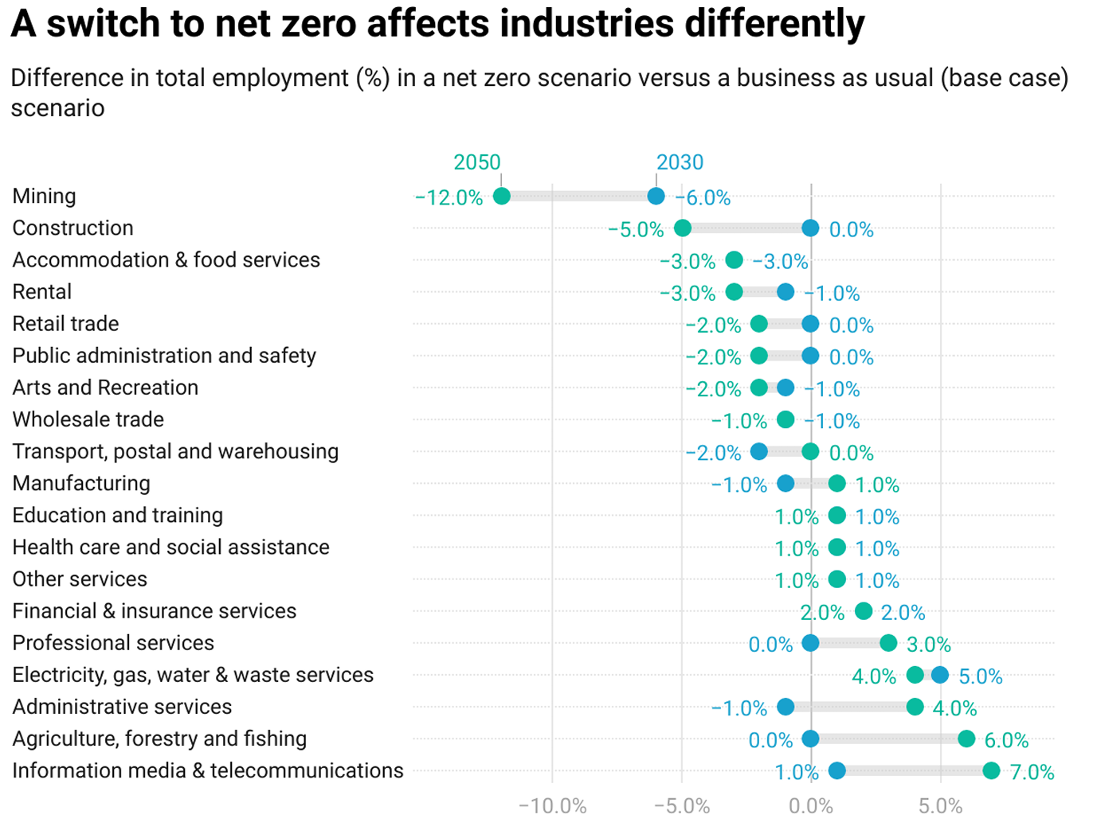
Net Zero ++ example: labour
Counting Down to Net Zero 2050: Australian Labour Market Impacts and Regional Training Responses
May 2023
Associate Professor Peter Hurley
Dr Melinda Hildebrandt
Dr Elizabeth Knight
Dr Chinh Nguyen
Dr Sam Hoang
Notes:
28. Victoria University.pdf
Figure 2 shows the absolute changes in employment by industry sector from the modelling. This indicates that although some sectors will experience significantly lower employment than in the base case, aggregate employment in every sector will nonetheless grow. So taking Mining as a prime example, although employment can be expected to decline by 12 per cent by 2050, relative to the base case, the model predicts an increase in employment in the Mining sector of 22.7 per cent over that period, which is about 435,000 more employed persons.
This document outlines research that examines the labour market impacts of zero emissions policies on specific Australian regions using data from modelling conducted by Professor Philip Adams from the Centre of Policy Studies and qualitative data collected from interviews with key stakeholders in the Latrobe Valley and the Hunter Valley.

Slide 8
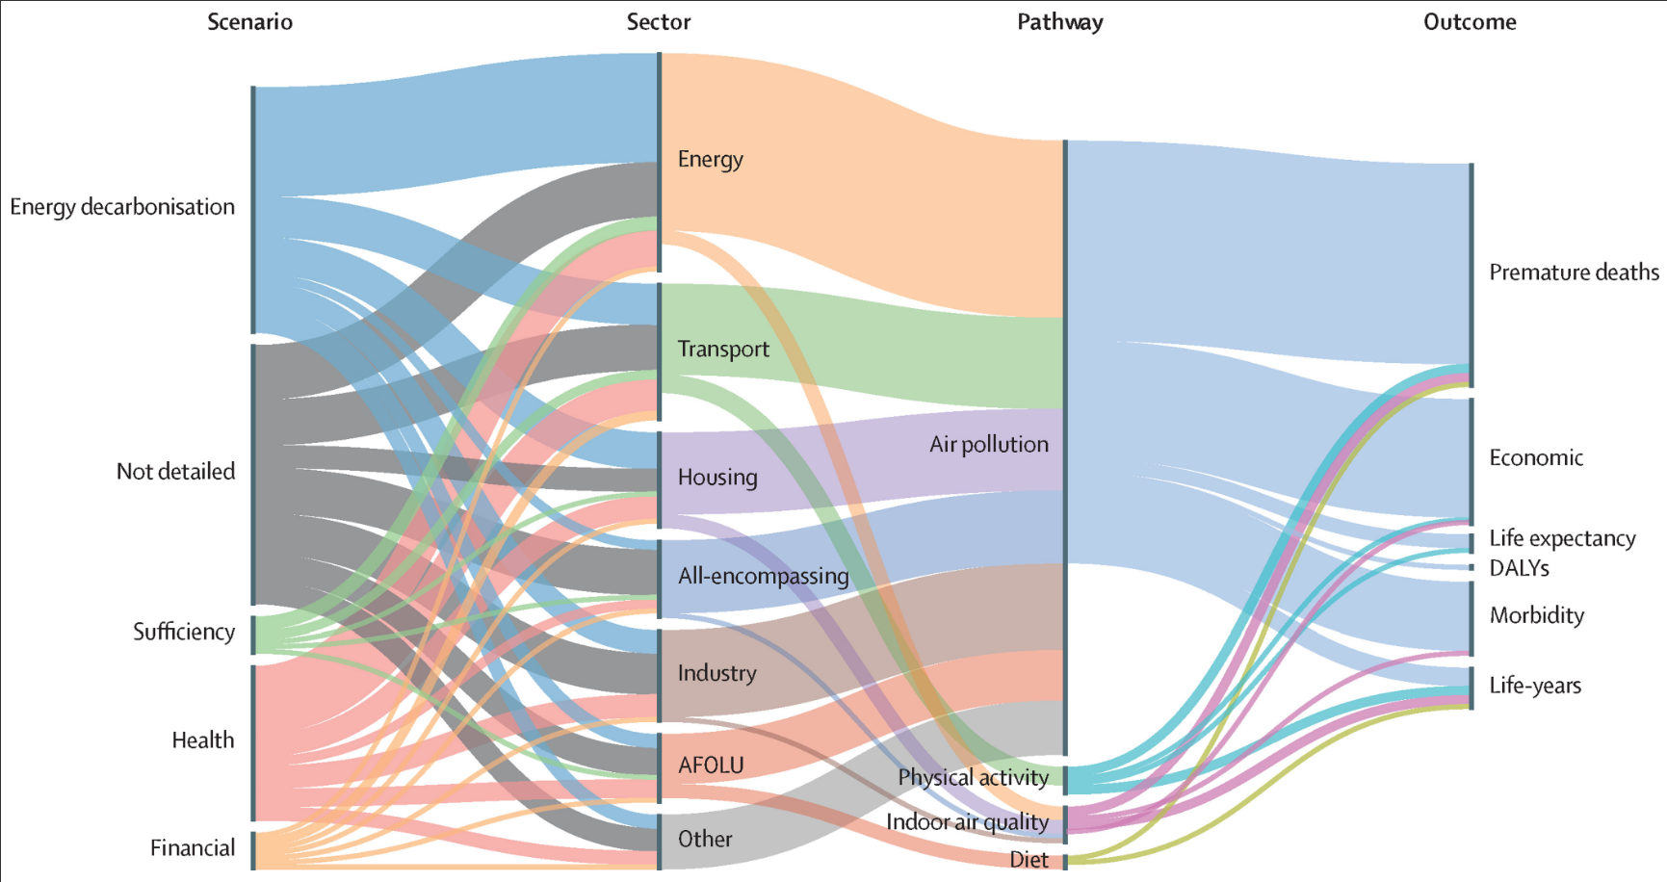

Net Zero ++ example: public health
Sankey diagram showing linkage between type of net-zero scenario, emission sector, co-benefit pathway, and health outcome
Notes:
Meta analysis The public health co-benefits of strategies consistent with net-zero emissions: a systematic review - The Lancet Planetary Health
Sankey diagram text: Net-zero scenarios can have links to several emissions sectors, co-benefit pathways, and health outcomes. Air pollution captures ambient air pollution only. Indoor air quality refers to the global quality of the indoor air environment. AFOLU=agriculture, forestry, and other land use. DALYs=disability-adjusted life-years. Several studies focused only on one sector could assess multiple types of scenarios; similarly, several studies only assessing one health pathway could rely on a multisectorial emission model.
Moving towards net-zero emission societies is projected to provide human health co-benefits. However, the magnitude of these co-benefits is poorly documented and might be context specific. Synthesising the evidence on these co-benefits could enhance the engagement of decision makers and populations in climate mitigation actions. We performed database searches of PubMed, Web of Science, and Scopus for studies published between database inception and Jan 1, 2024, identifying 3976 papers. Of these, 58 quantitative studies met our inclusion criteria and were included in this systematic review. These 58 papers explored 125 net-zero emission scenarios and considered various pathways by which climate policies can affect human health. Pathways addressing air quality, physical activity, and dietary changes found substantial health co-benefits, with a median mortality reduction of 1·5%. National or sub-national studies showed that net-zero policies would yield substantial local air quality benefits, independently of the actions taken in neighbouring countries. However, these co-benefits varied with explored emission sector, decarbonisation levers, modelling approach, and location. Studies that included a cost–benefit analysis estimated that monetised benefits outweighed the costs of implementing climate policies. This systematic review highlights the need for a standardised framework to assess and compare health impacts of climate mitigation actions across sectors and confirms that achieving net-zero goals supports far-reaching public health policies.
We identified 3976 records from the three databases, of which 1433 duplicates were removed (figure 1). All corresponding authors from included studies were contacted in December, 2023, to request potentially relevant unidentified peer-reviewed studies. Of the 2582 abstracts screened, 92 qualified for full-text screening. In the full-text assessment, 34 studies were excluded, mainly because they did not estimate quantitative health metrics (n=10) or because they were not explicitly based on net-zero scenarios (n=14). 58 studies met our inclusion criteria (appendix 2 pp 11–14).

Slide 9
Net Zero supporting frameworks and indicators
Frameworks and indicators supporting Net Zero measurement:
Enhanced Transparency Framework under the Paris Agreement and the UN Framework Convention on Climate Change (UNFCCC)
System of Environmental Economic Accounting, which includes energy and air emission accounts.
SEEA Ecosystem accounting
Global Set of Climate Change Statistics and Indicators
Framework for the Development of Environment Statistics (FDES) [see chapter 5 in particular] and the Manual on the Basic Set of Environment Statistics which has a chapter on ‘GHG Statistics’
Land Use, Land Use Change and Forestry (LULUCF) sector
Greenhouse gas protocol.
The System of National Accounts, particularly in relation to capital production and consumption.
Circular economy
Labour statistics and Labour Account.
Wellbeing framework
.

Slide 10
Storybook outline
Section 1: What is Net Zero and international commitments
Section 2: The role of National Statistical Organisations and National Statistical Systems
Section 3: Net Zero measurement framework: Net Zero, Net Zero + and Net Zero ++
Section 4: Mapping frameworks and indicators to the Net Zero measurement framework
Section 5: Country case studies
Section 6: Future opportunities

Slide 11
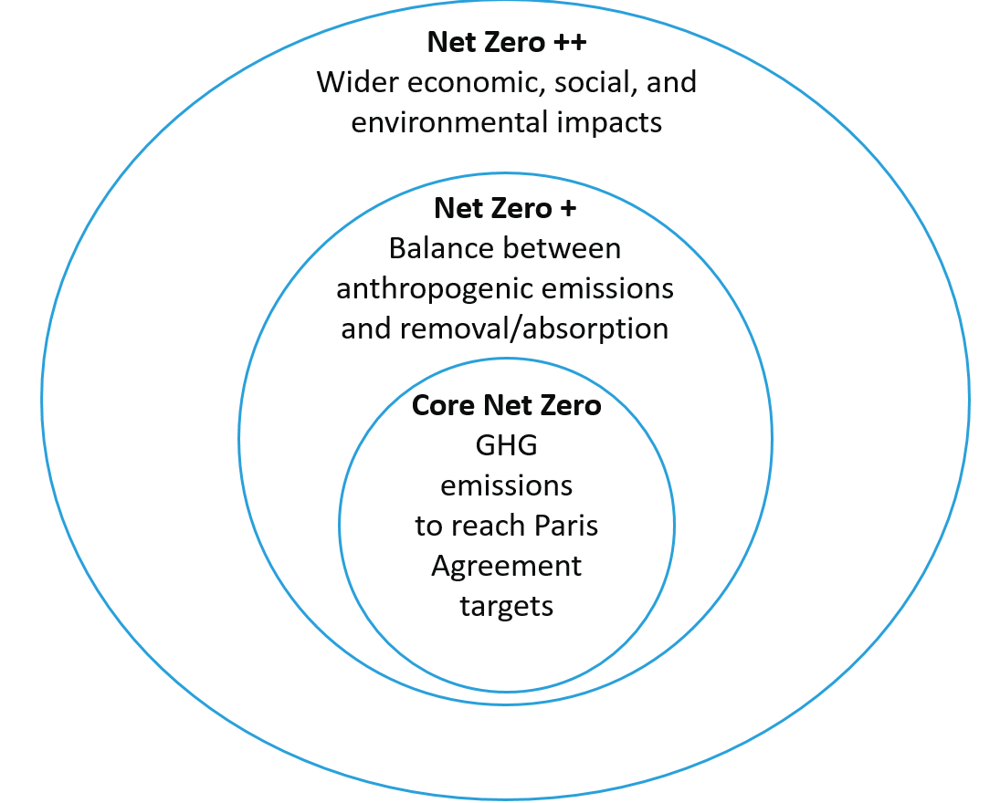
Questions
Reactions to the proposed Net Zero Storybook
Any case studies you know of for Net Zero + and Net Zero ++
Useful references to include

